Slide 1

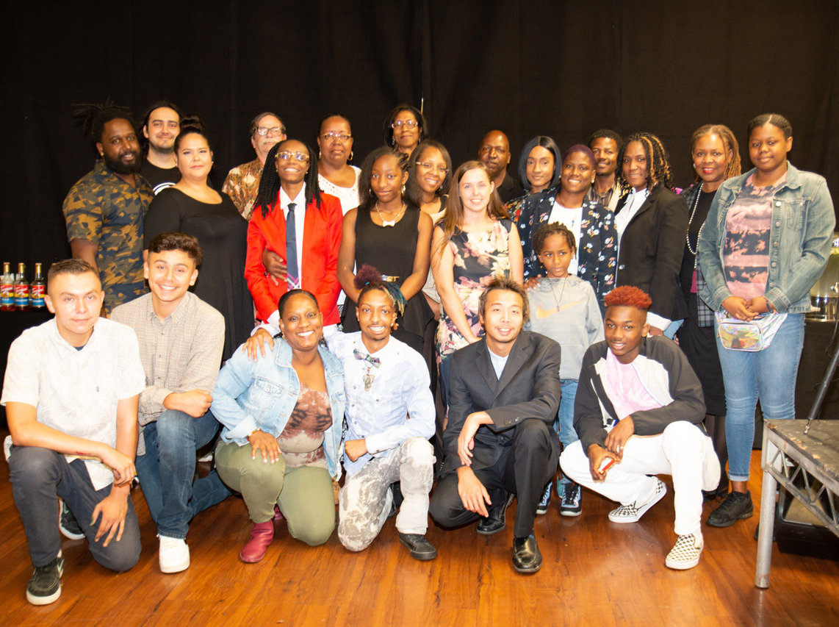
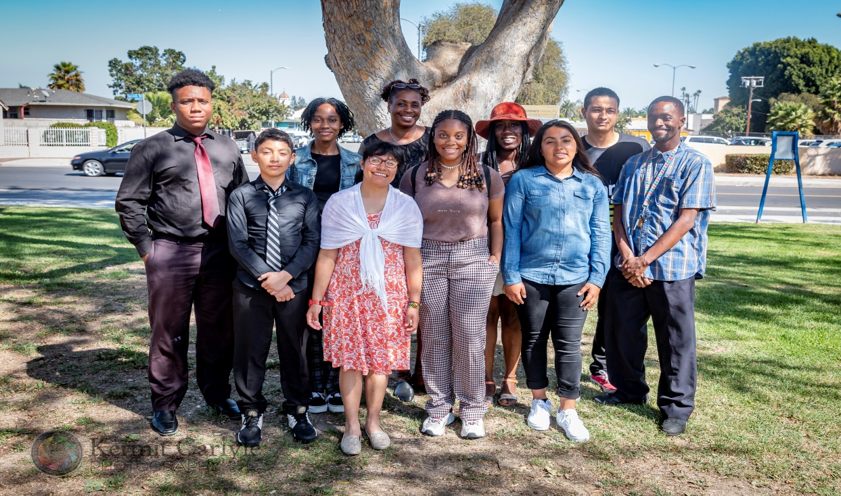
Our Mission
To assist, educate, train & mentor, multi-cultural entrepreneurs,
youth-at-risk, “handicapable” entrepreneurs, and people
re-entering
society, to start or expand small businesses in their community.
Miracle’s Young Adult Entrepreneur Program
Class of 2019

Slide 2
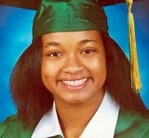
Miracle’s Miracle
The MYAEP model is named in honor of 15 year old Watts native Miracle Treasure McGowan, a student at Ánimo College Prep Academy charter school on the David Jordan High school campus. She tragically lost her life in January 2018, at the age of 15, to a random gunman while sitting in the family car with her mother who was wounded.
Miracle loved her community, was a tireless volunteer at Ted Watkins Park and had her heart set on attending college and using her skills to give-back and improve the neighborhood she grew up in and loved. Miracle planned to work at the park while she attended college. Everyone loved Miracle, and her family feels that this program will represent the goodness and upward mobility they saw for her future.

Slide 3
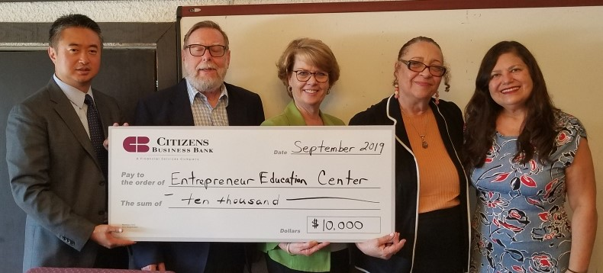
Banking On Miracle’s
Citizens Business Bank Joins 11 International Financial Institutions
supporting Miracle’s Young Adult Entrepreneur Program with a $10,000 dollar grant in support of EECI’s mission to build a better community, one small business at a time. (From L-R) Michael Park, CBB VP/Relationship Manager, Susan Montoya, CBB VP/Community Development Officer, Reynold Blight, EECI Board, Barbara J. Stanton, EECI Exec Dir., and Monica Castaneda, EECI Board.

Slide 4
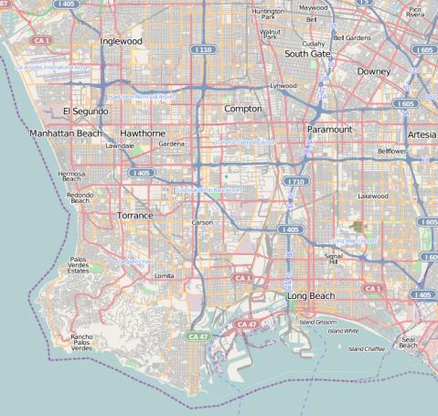
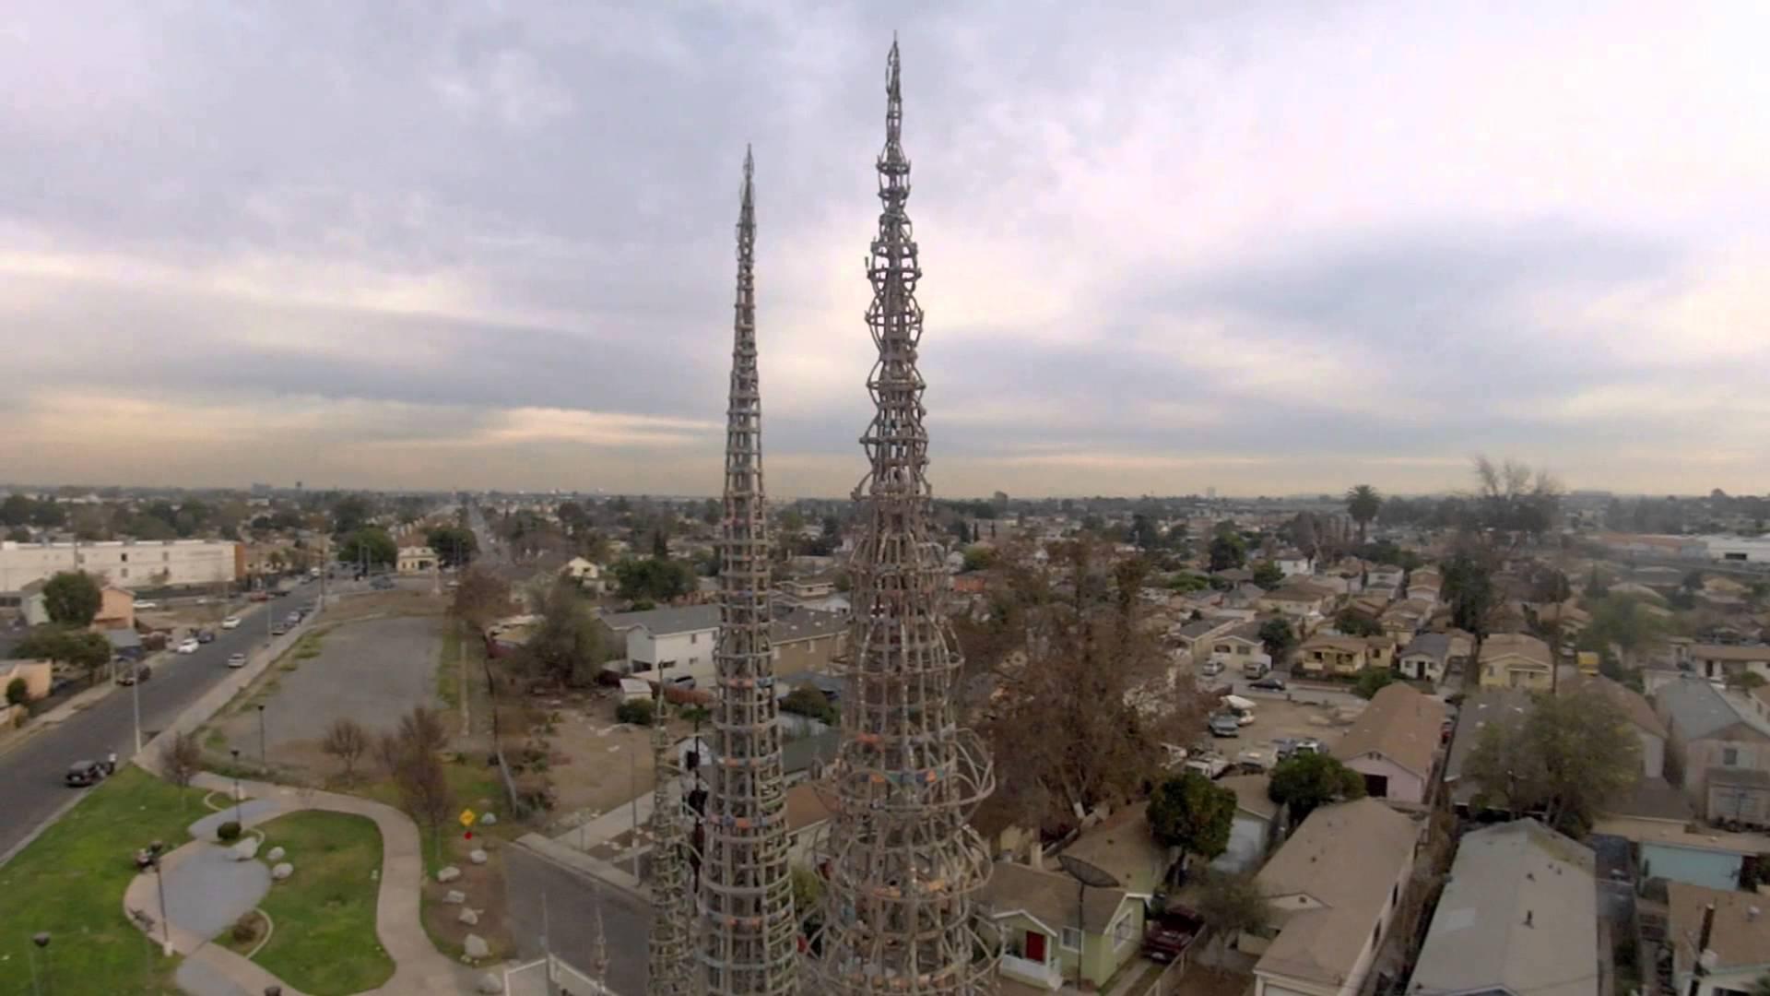
Target Area - 1 Million + Residents
The Underserved Communities of:
  Watts
  Willowbrook
  Compton
  Gardena
  Southgate
  Lynwood
  Carson

Slide 5
Statement of Need
Source: National Decision Systems report based on updated 2005 U.S. Census data with projections, the target community is in need of access to information and infrastructure technology.
    56% of adults (25 and older) have failed to complete high school
    Less than 4% have obtained a bachelor’s degree
    48% of the population (16 & older) are unemployed
    58% of average household incomes are less than $35,000
    Estimated per capita income is $10,308
    38% have White Collar occupations, 46.1% are Blue Collar, and 16.1% are Administrative Support

Slide 6

Goals & Objectives
Provide avenues for the development of business talents of the target area’s more than one million residents
Develop links between the corporate community and the target community to maximize productivity in both economic sectors.
Promote the advantages of entrepreneurial education - more than 80% of all newly created jobs are created through small businesses.
Connect successful entrepreneurs with financial resources for the expansion of their small businesses, and how to qualify for business loans.
Develop a loan pool for the graduates of the EECI Program.
Assist the development of new community leaders.

Slide 7
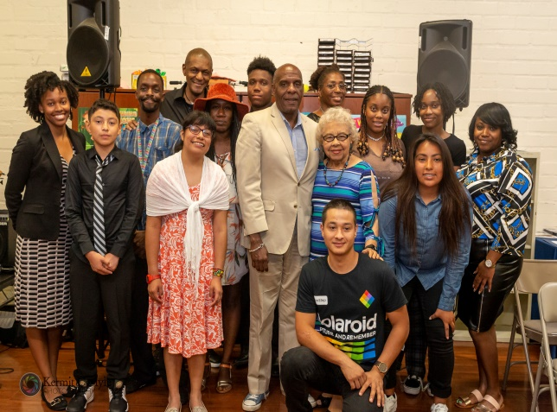
Methodology
The EECI Young Adult Program consists of five major components implemented over a nine-month period:
outreach, screening and enrollment
classroom seminars
round table discussions and workshops
individualized consulting and mentoring
field trips
Each student has approximately 100 hours of service. The course culminates in a graduation ceremony.

Slide 8
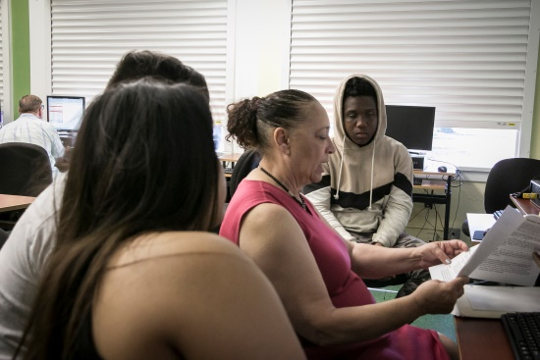
Entrepreneurial Classroom Instruction
The Mind Set and Success Traits
The Concept and Feasibility
Legal Aspects of Business
Entry Strategies
Planning
Marketing
Management Financial Planning
Money – Where It is and How to Get It
Need for Growth Strategy
Methods of Growing
Expansion of Sales Operations
Managing and Financing Growth
Buying a Business
Evaluation of Growth Plan
The Future

Slide 9
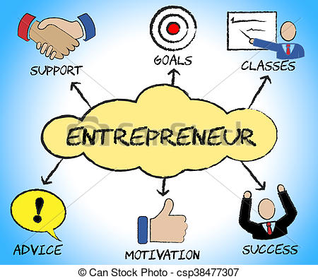
Life! Employment! Career Prep!
Individuals will participate in specialized Personal and Professional Development Classes including, but not be limited to:
    Bridging Higher Education (College) with Various Industry Careers
    Preparing A Personal Mission Statement
    Preparing A Student/Personal Bio and Resume Writing
    Presenting Your Best for Colleges and Career Paths
    The College Application Process & Financial Aid
    Learning Styles & Critical and Creative Thinking
    Successful Test Taking, Time Management and Study Skills
    Wellness & Well-Being
    Forming Positive Relationships (Networking)
    Interviewing & Informational Interviews
    Parent Orientation

Slide 10
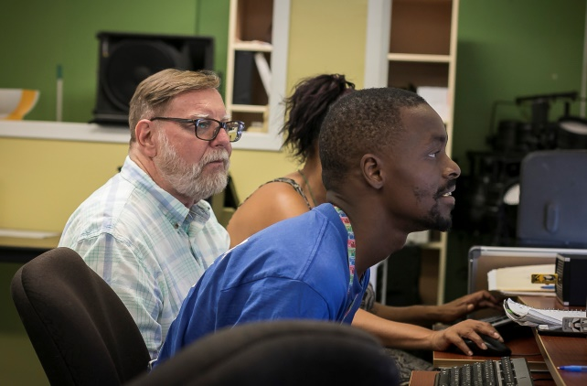
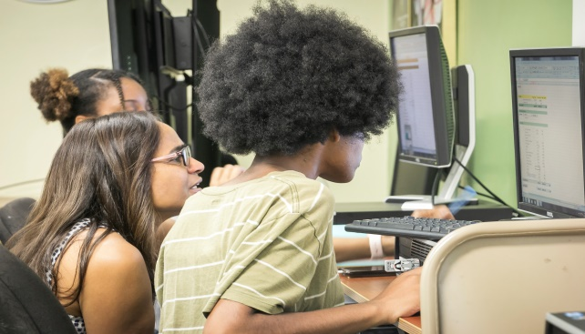
College Prep & Pre-Employment
Keys to Success
Defining Who You Are
Achieving Your Goals
Time Management
Mapping Your Course
Note-Taking and Study Skills
Career Planning Life Mission
Teamwork
Punctuality/Meeting Deadlines
Customer Service
Budgeting
Phone Etiquette & Communication Skills

Slide 11


Individual/Group Consulting
Ongoing individual consulting will be offered and scheduled for each participant with a Teaching Assistant and Mentor assigned to each student.
Computer Literacy
Writing Efficiency

Slide 12

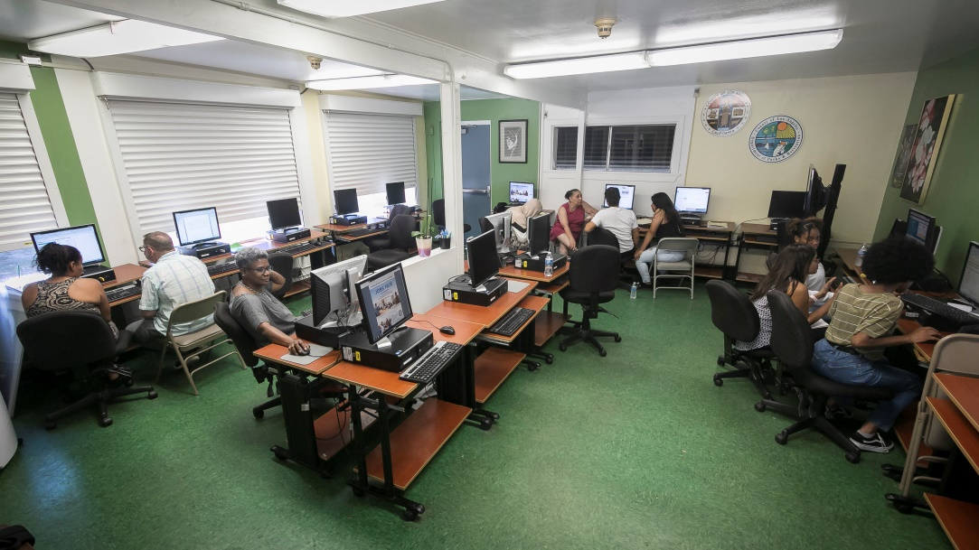

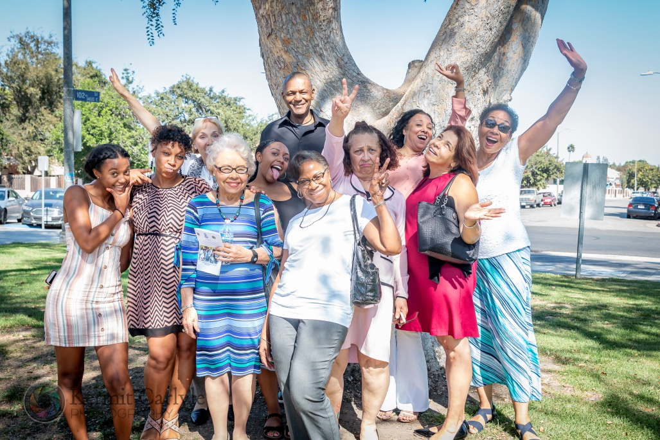






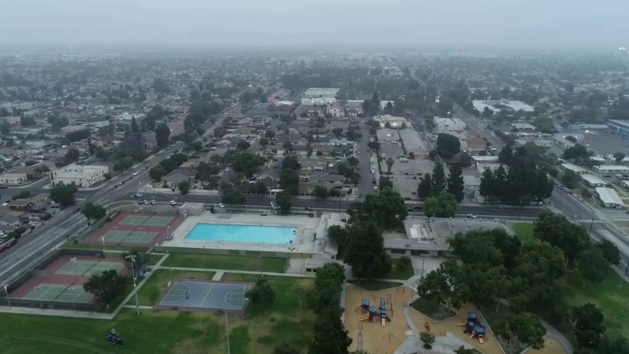

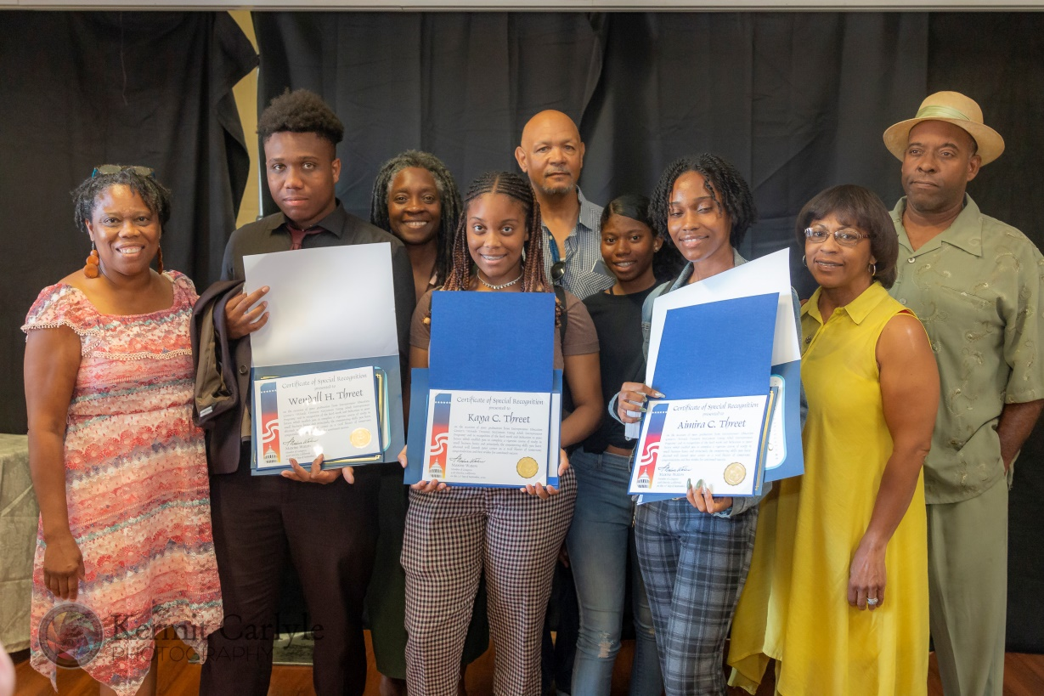



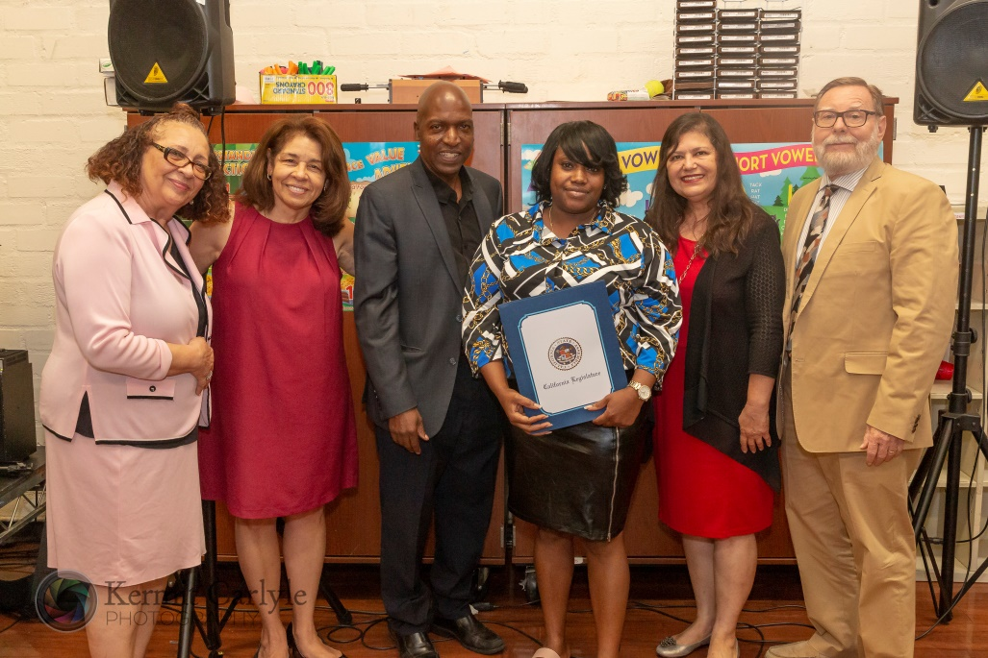









Supervisor
Mark Ridley-Thomas
Second District

